Slide 1
Chapter 2
Get started fast with JavaScript

Slide 2
Objectives (part 1)
Applied
Given the specifications for a JavaScript application that requires only the skills that you’ve learned so far, code, test, and debug the application.
Knowledge
Describe two ways to include JavaScript in the body of an HTML document.
Describe how case-sensitivity, semicolons, and whitespace relate to the syntax for a JavaScript statement.
List the primary rules for creating a JavaScript identifier.
Describe the use of JavaScript comments, including “commenting out” portions of JavaScript code.

Slide 3
Objectives (part 2)
Describe these three primitive data types that are available from JavaScript: numeric, string, and Boolean.
Describe the use of variable and constant declarations and assignment statements with numeric, string, and Boolean data.
Distinguish between using the let and const keywords to declare constants and variables and using the var keyword to declare variables and constants.
Describe the use of the arithmetic operators and the rules for evaluating an arithmetic expression, including order of precedence and the use of parentheses.
Distinguish between using the + operator and a template string literal when working with strings.
Explain how to use an escape sequence such as \n to include a special character in a string.

Slide 4
Objectives (part 3)
Describe the syntax for referring to a method or property of an object.
Describe the use of the alert(), prompt(), parseInt(), parseFloat(), write(), and toFixed() methods.

Slide 5
Two attributes of the script element
src
type
A script element in the body section that loads an external JavaScript file
<body>
...
<script src="calculate_mpg.js"></script>
</body>

Slide 6
A script element that embeds JavaScript in the body section
<body>
...
<script>
alert("The Calculate MPG application");
let miles = prompt("Enter miles driven");
miles = parseInt(miles);
let gallons =
prompt("Enter gallons of gas used");
gallons = parseInt(gallons);
let mpg = miles/gallons;
mpg = parseFloat(mpg);
alert("Miles per gallon = " + mpg);
</script>
</body>

Slide 7
Terms related to including JavaScript
external JavaScript file
embedded JavaScript

Slide 8
An HTML page with two noscript elements
<body>
<header>
<h1>Welcome to my website!</h1>
<noscript>
<h2>To get the most from this website, please
enable JavaScript in your browser.</h2>
</noscript>
</header>
<!-- main HTML for page goes here -->
<footer>
<script>
const today = new Date();
document.write(`Today is ${today.toDateString()}.`);
</script>
<noscript>
Today is the first day of the rest of your life.
</noscript>
</footer>
</body>

Slide 9
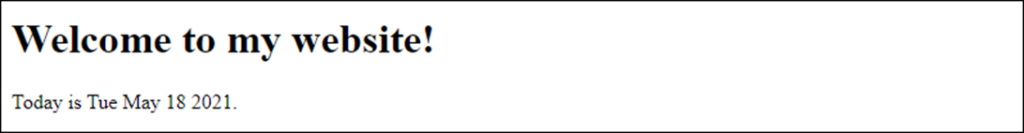
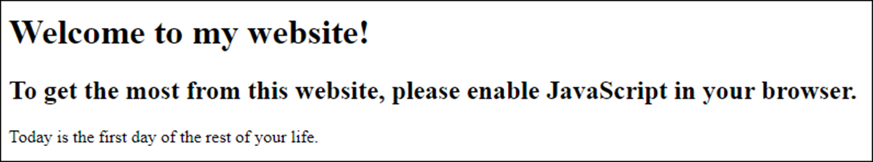
The page in a browser with JavaScript enabled
The page in a browser with JavaScript disabled

Slide 10
How to disable JavaScript in Chrome
Click the menu button in the upper right corner of the browser window.
Select Settings, then scroll to the “Privacy and security” section.
Expand Site Settings, then scroll to and expand the JavaScript item.
Toggle the Allowed switch to Blocked.
How to enable JavaScript in Chrome
Follow the procedure above, but toggle the Blocked switch to Allowed.

Slide 11
The basic syntax rules for JavaScript
JavaScript is case-sensitive.
Each JavaScript statement ends with a semicolon.
JavaScript ignores extra whitespace within statements.
When JavaScript is in strict mode, it disallows certain JavaScript features and coding practices that are considered unsafe.

Slide 12
JavaScript code that follows the syntax rules
const joinList = function() {
"use strict";
const emailAddress1 = $("#email_address1").value;
const emailAddress2 = $("#email_address2").value;
const firstName = $("#first_name").value;
if (emailAddress1 == "") {
alert("Email Address is required.");
} else if (emailAddress2 == "") {
alert("Second Email Address is required.");
} else if (emailAddress1 != emailAddress2) {
alert("Second Email entry must equal first entry.");
} else if (firstName == "") {
alert("First Name is required.");
} else {
$("email_form").submit();
}
};

Slide 13
How to split a statement over two or more lines
Split a statement after:
an arithmetic or relational operator such as +, -, *, /, =, ==, >, or <
an opening brace ( { ), bracket ( [ ), or parenthesis
a closing brace ( } )
Do not split a statement after:
an identifier, a value, or the return keyword
a closing bracket ( ] ) or closing parenthesis

Slide 14
Rules for creating identifiers
Identifiers can only contain letters, numbers, the underscore, and the dollar sign.
Identifiers can’t start with a number.
Identifiers are case-sensitive.
Identifiers can be any length.
Identifiers can’t be the same as reserved words.
Avoid using global properties and methods as identifiers.

Slide 15
Valid identifiers in JavaScript
Subtotal
index_1
$
taxRate
calculate_click
$log

Slide 16
Camel casing versus snake casing
taxRate tax_rate
calculateClick calculate_click
emailAddress email_address
futureValue future_value

Slide 17
Naming recommendations for identifiers
Use meaningful names for identifiers. That way, your identifiers aren’t likely to be reserved words or global properties.
Be consistent: Either use camel casing (taxRate) or snake casing (tax_rate) to identify the words within the variables in your scripts.
If you use snake casing, use lowercase for all letters.

Slide 18
Reserved words in JavaScript
abstract else instanceof switch
arguments enum int synchronized
boolean eval interface this
break export let throw
byte extends long throws
case false native transient
catch final new true
char finally null try
class float package typeof
const for private var
continue function protected void
debugger goto public volatile
default if return while
delete implements short with
do import static yield
double in super

Slide 19
JavaScript code with comments highlighted
/* this application validates a user's entries for joining
our email list
*/
"use strict";
const $ = function(selector) { // the $ function
return document.querySelector(selector);
}
// this function gets and validates the user entries
const joinList = function() {
const emailAddress1 = $("#email_address1").value;
const emailAddress2 = $("#email_address2").value;
const firstName = $("#first_name").value;
let isValid = true; // set default value
// validate the first entry
if (emailAddress1 == "") {
$("email_address1_error").textContent = "This field is required.";
isValid = false; // set valid flag to off
} else {
$("email_address1_error").textContent = "";
}
// validate the second entry
...
...
};

Slide 20
The basic syntax rules for JavaScript comments
Block comments begin with /* and end with */.
Single-line comments begin with two forward slashes and continue to the end of the line.
Guidelines for using comments
Use comments to describe portions of code that are hard to understand.
Use comments to disable portions of code that you don’t want to test.
Don’t use comments unnecessarily.

Slide 21
Terms related to JavaScript syntax
statement
whitespace
strict mode
identifier
camel casing
snake casing
comment
comment out

Slide 22
JavaScript’s primitive data types
Number
String
Boolean
Symbol
Null
Undefined
BigInt (ES2020)

Slide 23
Examples of number values
15 // an integer
-21 // a negative integer
21.5 // a decimal value
-124.82 // a negative decimal value
-3.7e-9 // floating-point notation for -0.0000000037
The number data type
A number value can be an integer or a decimal value.
In JavaScript, decimal values are stored as floating-point numbers.
If a result is stored in a number data type that is larger or smaller than the data type can store, it will be stored as the value Infinity or -Infinity.

Slide 24
Examples of string values
"JavaScript" // a string with double quotes
'String Data' // a string with single quotes
"" // an empty string
The string data type
A string value is surrounded by double quotes or single quotes. The string must start and end with the same type of quotation mark.
An empty string is a string that contains no characters. It is entered by typing two quotation marks with nothing between them.

Slide 25
The two Boolean values
true // equivalent to true, yes, or on
false // equivalent to false, no, or off
The Boolean data type
A Boolean value can be true or false. Boolean values are often used in conditional statements.

Slide 26
How to declare and initialize a variable
Syntax
let variableName = value;
Examples
let count = 1; // integer value of 1
let subtotal = 74.95; // decimal value of 74.95
let name = "Joseph"; // string value of "Joseph"
let email = ""; // empty string
let isValid = false; // Boolean value of false
let total = subtotal; // assigns value of subtotal variable
let x = 0, y = 0; // declares and initializes
// 2 variables
How to reassign the value of a variable
let count = 1;
count = count + 1; // value of count is now 2

Slide 27
How to declare and initialize a constant
Syntax
const constantName = value;
Examples
// same as for variable but with const keyword
What happens if you try to reassign the value of a constant
const count = 1;
count = count + 1; // TypeError: Assignment to
// constant variable.

Slide 28
How JavaScript processes variable and constant declarations
JavaScript places all variable and constant declarations in memory first. This is called hoisting.
When a variable that’s declared with the var keyword is hoisted, JavaScript initializes it with a value of undefined. Because of this, you can access the variable before you declare it, but its value will be undefined.
When a variable that’s declared with the let keyword is hoisted, JavaScript doesn’t initialize it. That’s also true of a constant. Because of this, you can’t access the variable or constant before you declare it.

Slide 29
A variable declared with the var keyword
Accessed before it’s declared
alert(val1); // displays "undefined"
var val1 = "value";
Accessed after it’s declared
var val1 = "value";
alert(val1); // displays "value"
A variable declared with the let keyword
Accessed before it’s declared
alert(val2); // ReferenceError – nothing displays
let val2 = "value";
Accessed after it’s declared
let val2 = "value";
alert(val2); // displays "value"

Slide 30
Terms related to variables and constants
variable
constant
declare a variable or constant
initialize a variable or constant
assignment statement
assignment operator
literal value
literal
string literal
numeric literal
hoisting
temporal dead (TDZ)

Slide 31
JavaScript’s arithmetic operators
Operator Name Description
+ Addition Adds two operands.
- Subtraction Subtracts the right operand from the left operand.
* Multiplication Multiplies two operands.
/ Division Divides the right operand into the left operand. The result is always a floating-point number.
% Modulus Divides the right operand into the left operand and returns the remainder.
++ Increment Adds 1 to the operand.
-- Decrement Subtracts 1 from the operand.

Slide 32
The order of precedence for arithmetic operators
Order Operators Direction Description
1 ++ Left to right Increment operator
2 -- Left to right Decrement operator
3 * / % Left to right Multiplication, division, modulus
4 + - Left to right Addition, subtraction

Slide 33
Examples of simple arithmetic expressions
Example Result
5 + 7 12
5 - 12 -7
6 * 7 42
13 / 4 3.25
13 % 4 1
counter++ counter = counter + 1
counter-- counter = counter – 1
3 + 4 * 5 23 (the multiplication is done first)
(3 + 4) * 5 35 (the addition is done first)
13 % 4 + 9 10 (the modulus is done first)
13 % (4 + 9) 0 (the addition is done first)

Slide 34
Code that calculates sales tax
const subtotal = 200;
const taxPercent = .05;
const taxAmount = subtotal * taxPercent; // 10
const total = subtotal + taxAmount; // 210
Code that calculates the perimeter of a rectangle
const width = 4.25;
const length = 8.5;
const perimeter = (2 * width) + (2 * length)
// (8.5 + 17) = 25.5

Slide 35
The most useful compound assignment operators
Operator Description
+= Adds the result of the expression to the variable.
-= Subtracts the result of the expression from the variable.
*= Multiplies the variable value by the result of the expression.
Statements with compound assignment operators
let subtotal = 74.95;
subtotal += 20.00; // subtotal = 94.95
let counter = 10;
counter -= 1; // counter = 9
let price = 100;
price *= .8; // price = 80

Slide 36
Three ways to increment a variable by 1
let counter = 1; // counter = 1
counter = counter + 1; // counter now = 2
counter += 1; // counter now = 3
counter++; // counter now = 4

Slide 37
A floating-point result that isn’t precise
const subtotal = 74.95; // subtotal = 74.95
const salesTax = subtotal * .1;
// salesTax = 7.495000000000001
A problem with some arithmetic operations
When you do some types of arithmetic operations with decimal values, the results aren’t always precise. That’s because decimal values are stored internally as floating-point numbers.
The primary problem with this is that an equality comparison may not return true.

Slide 38
Terms related to arithmetic expressions
arithmetic expression
arithmetic operators
order of precedence
compound assignment operators

Slide 39
The concatenation operators for strings
Operator Description
+ Concatenates two values.
+= Concatenates the result of the expression to the end of the variable.

Slide 40
Constants used by the following examples
const firstName = "Grace", lastName = "Hopper";
How to concatenate string variables with the + operator
const name = lastName + ", " + firstName;
// name is "Hopper, Grace"
How to concatenate string variables with the += operator
let name = lastName; // name is "Hopper"
name += ", "; // name is "Hopper, "
name += firstName; // name is "Hopper, Grace"
How to concatenate string variables with a template literal
const name = `${lastName}, ${firstName}`;
// name is "Hopper, Grace"

Slide 41
How to concatenate on multiple lines
const greeting = "Hello";
const price = 15.99; // number data type
const isValid = true; // boolean data type
With the + operator
const message = greeting + "! Is the price really " +
"just " + price + "? Answer: " + isValid + ".";
// message is "Hello! Is the price really just 15.99?
// Answer: true."
With a template literal
const message2 = `${greeting}! Is the price really
just ${price}? Answer: ${isValid}.`;
// message is "Hello! Is the price really just 15.99?
// Answer: true."

Slide 42
Some of the escape sequences that can be used in strings
Operator Description
\n Starts a new line in a string. Doesn’t affect HTML but does work with the text in alerts and prompts.
\' Puts a single quotation mark in a string.
\" Puts a double quotation mark in a string.
\\ Puts a backslash in a string.

Slide 43
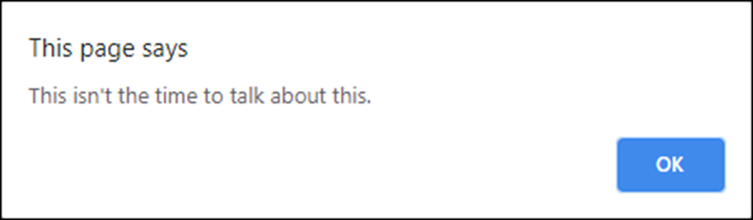
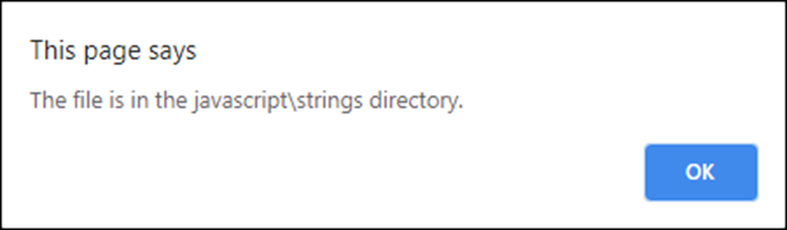
How escape sequences can be used in a string
alert("This isn\'t the time to talk about this.");
alert("The file is in the javascript\\strings directory.");

Slide 44
Some of the codes for Unicode characters
Code Character Description
\u00A9 © Copyright
\u00AE ® Registered trademark
\u263A ☺ Smiley face
\u2665 ♥ Heart

Slide 45
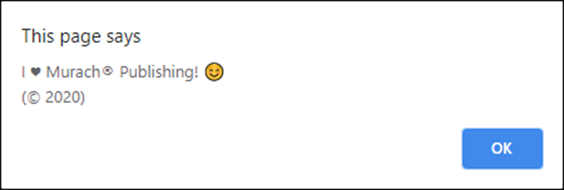
How Unicode characters can be used in a string
alert("I \u2665 Murach\u00AE Publishing! \u263A \n(\u00A9 2020)");
A website that lists all the Unicode characters
https://en.wikipedia.org/wiki/List_of_Unicode_characters

Slide 46
Terms related to strings
concatenate (join) strings
concatenation operators
template literal
string expression
escape sequences
Unicode characters

Slide 47
Common methods of the window object
alert(string)
prompt(string, default)
The syntax for calling a method of an object
objectName.methodName(parameters)
A statement that calls the alert() method of the window object
window.alert("This is a test of the alert method");

Slide 48
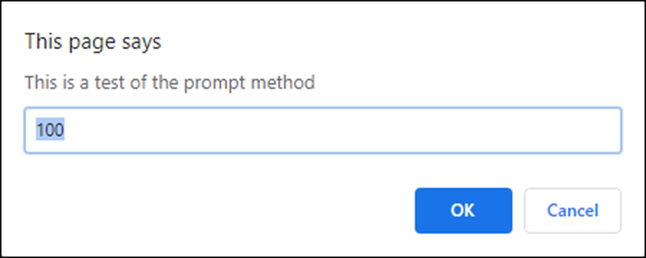
A statement that calls the prompt() method with the object name omitted
const userEntry = prompt("This is a test of the prompt method", 100);
The prompt dialog box that’s displayed

Slide 49
One property of the window object
location
The syntax for accessing a property of an object
objectName.propertyName
A statement that displays the URL of the current page
alert(window.location);

Slide 50
Two methods of the window object
parseInt(string)
parseFloat(string)
The parsing that’s done by the parse methods
Only the first number in the string is returned.
Leading and trailing spaces are removed.
If the first character cannot be converted to a number, NaN is returned.

Slide 51
Examples that use the parseInt() and parseFloat() methods
let entryA = prompt("Enter any value", 12345.6789);
alert(entryA); // displays 12345.6789
entryA = parseInt(entryA);
alert(entryA); // displays 12345
let entryB = prompt("Enter any value", 12345.6789);
alert(entryB); // displays 12345.6789
entryB = parseFloat(entryB);
alert(entryB); // displays 12345.6789
let entryC = prompt("Enter any value", "Hello");
alert(entryC); // displays Hello
entryC = parseInt(entryC);
alert(entryC); // displays NaN

Slide 52
The same examples with the parse methods embedded in the alert() method
const entryA =
parseInt(prompt("Enter any value", 12345.6789));
alert(entryA); // displays 12345
const entryB =
parseFloat(prompt("Enter any value", 12345.6789));
alert(entryB); // displays 12345.6789
const entryC =
parseInt(prompt("Enter any value", "Hello"));
alert(entryC); // displays NaN

Slide 53
A method of the document object
write(string)
An example that uses the write() method
<body>
</main>
<h1>Hello!</h1>
<p>Today's Date is
<script>
const today = new Date();
document.write(today.toDateString());
</script></p>
<p>We hope you enjoy our website!</p>
</main>
<footer>
<script>
document.write(`Copyright \u00A9
${today.getFullYear()}`);
</script>
</footer>
</body>

Slide 54
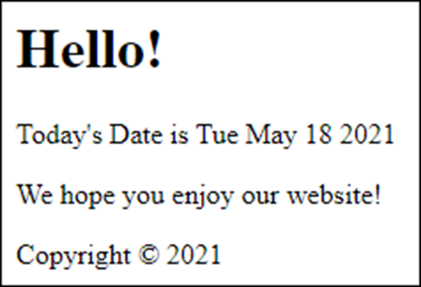
The output from the write() method in a browser

Slide 55
A method of the Number object
toFixed(n)
An example that uses the toFixed() method
const pi = 3.14159;
alert(pi.toFixed(3)); // displays 3.142

Slide 56
Terms related to objects
object
method
property
call a method
parameter
window object
global object
dot operator
document object
Number object

Slide 57
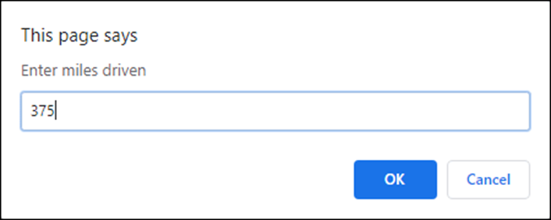
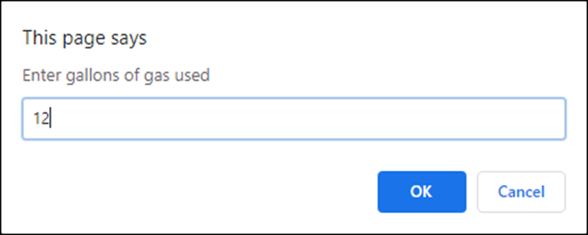
The Miles Per Gallon application (part 1)
The first prompt dialog box
The second prompt dialog box

Slide 58
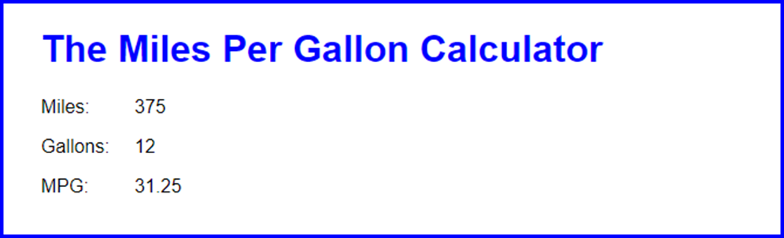
The Miles Per Gallon application (part 2)
The results displayed in the browser

Slide 59
The HTML and JavaScript for the MPG application
<body>
<h1>The Miles Per Gallon Calculator</h1>
<script>
"use strict";
// get miles driven from user
const miles = parseInt(prompt("Enter miles driven"));
// get gallons used from user
const gallons =
parseInt(prompt("Enter gallons of gas used"));
// calculate mpg
const mpg = parseFloat(miles/gallons);
const html = `<p><label>Miles: </label>${miles}</p>
<p><label>Gallons: </label>${gallons}</p>
<p><label>MPG: </label>${mpg.toFixed(2)}</p>`;
document.write(html);
</script>
</body>

Slide 60

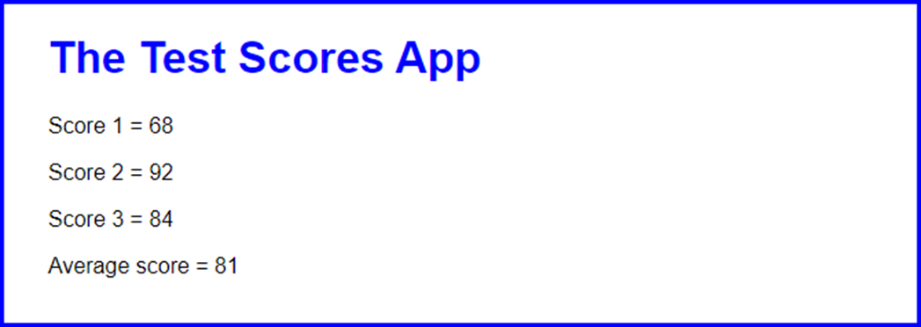
The first prompt of the Test Scores application
The results displayed in the browser

Slide 61
The HTML for the Test Scores application with an external JavaScript file
<body>
<h1>The Test Scores App</h1>
<script src="test_scores.js"></script>
</body>

Slide 62
The test_scores.js file
"use strict";
let total = 0; // initialize total variable
const score1 = parseInt(prompt("Enter test score"));
total += score1;
const score2 = parseInt(prompt("Enter test score"));
total += score2;
const score3 = parseInt(prompt("Enter test score"));
total += score3;
const average = parseInt(total/3);
const html = `<p>Score 1 = ${score1}</p>
<p>Score 2 = ${score2}</p>
<p>Score 3 = ${score3}</p>
<p>Average score = ${average}</p>`;
document.write(html);

